Slide 1
Project 1 – Team 1
Impact of the Government Shutdowm
Team:
Andrew Grimaldi Damita Zweiback
Jade Belton Leca Doyle
1/10/2019

Slide 2
Project Team 1 - Proposal
Project Title: Impact of the Government Shutdown Across Domains
Team Members: Andrew G., Damita Z., Jade, Leca
Project Description/Outline: The aim of this project is to demonstrate the use of various sources to show the impact of the government shut down on various sectors of the population.
Research Questions to Answer: Are comments on Twitter more favorable or unfavorable toward the wall, given the impact of the government shutdown?
Data Sets to be Used: Census, Bureau of Labor Statistics, & Twitter
Rough Breakdown of Tasks:
Jade: Census, Zip Codes Impacted Most by Government Shutdown
Andrew: Census, Twitter and Employment Impact?
Leca: Census and Income Areas?
Damita: Twitter, Favorable/Unfavorable Opinions about the Wall

Slide 3
Heat Map – Where in the US do federal employees work?
Step 1: Find the data source (OPM)
Step 2: Clean the data
.merge() – to merge two files together
.dropna() – to drop null values
.rename() – to rename column headers
== - to only get info from US
!= - to weed out “US” locations that had unspecified state information
Combined two columns to create a new DataFrame
.split() – to remove number and “-” in state name
.get() – to get data after the “-”
.title() – to change CAPS to Title
.value_counts() – to sum employee count by state

Slide 4
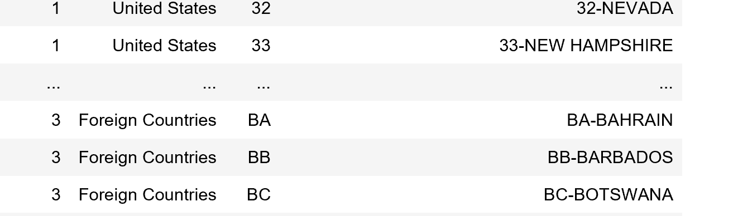
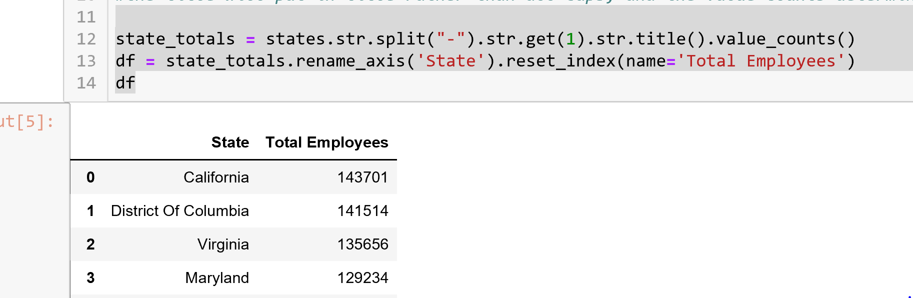

Slide 5
Heat Map - Continued
Step 3: Getting API information for state longitude and latitude
Create new columns in DataFrame
Set up empty variable to store API information
.iterrows() – to iterate through API and pull longitude and latitude for each state using Gmaps GeoData library
Step 4: Creating the Heat Map
New variables for longitude and latitude coordinates
astype() to make sure employees were set up as a float values
Gmaps library
Add heatmap layer against total number of state employees per state

Slide 6
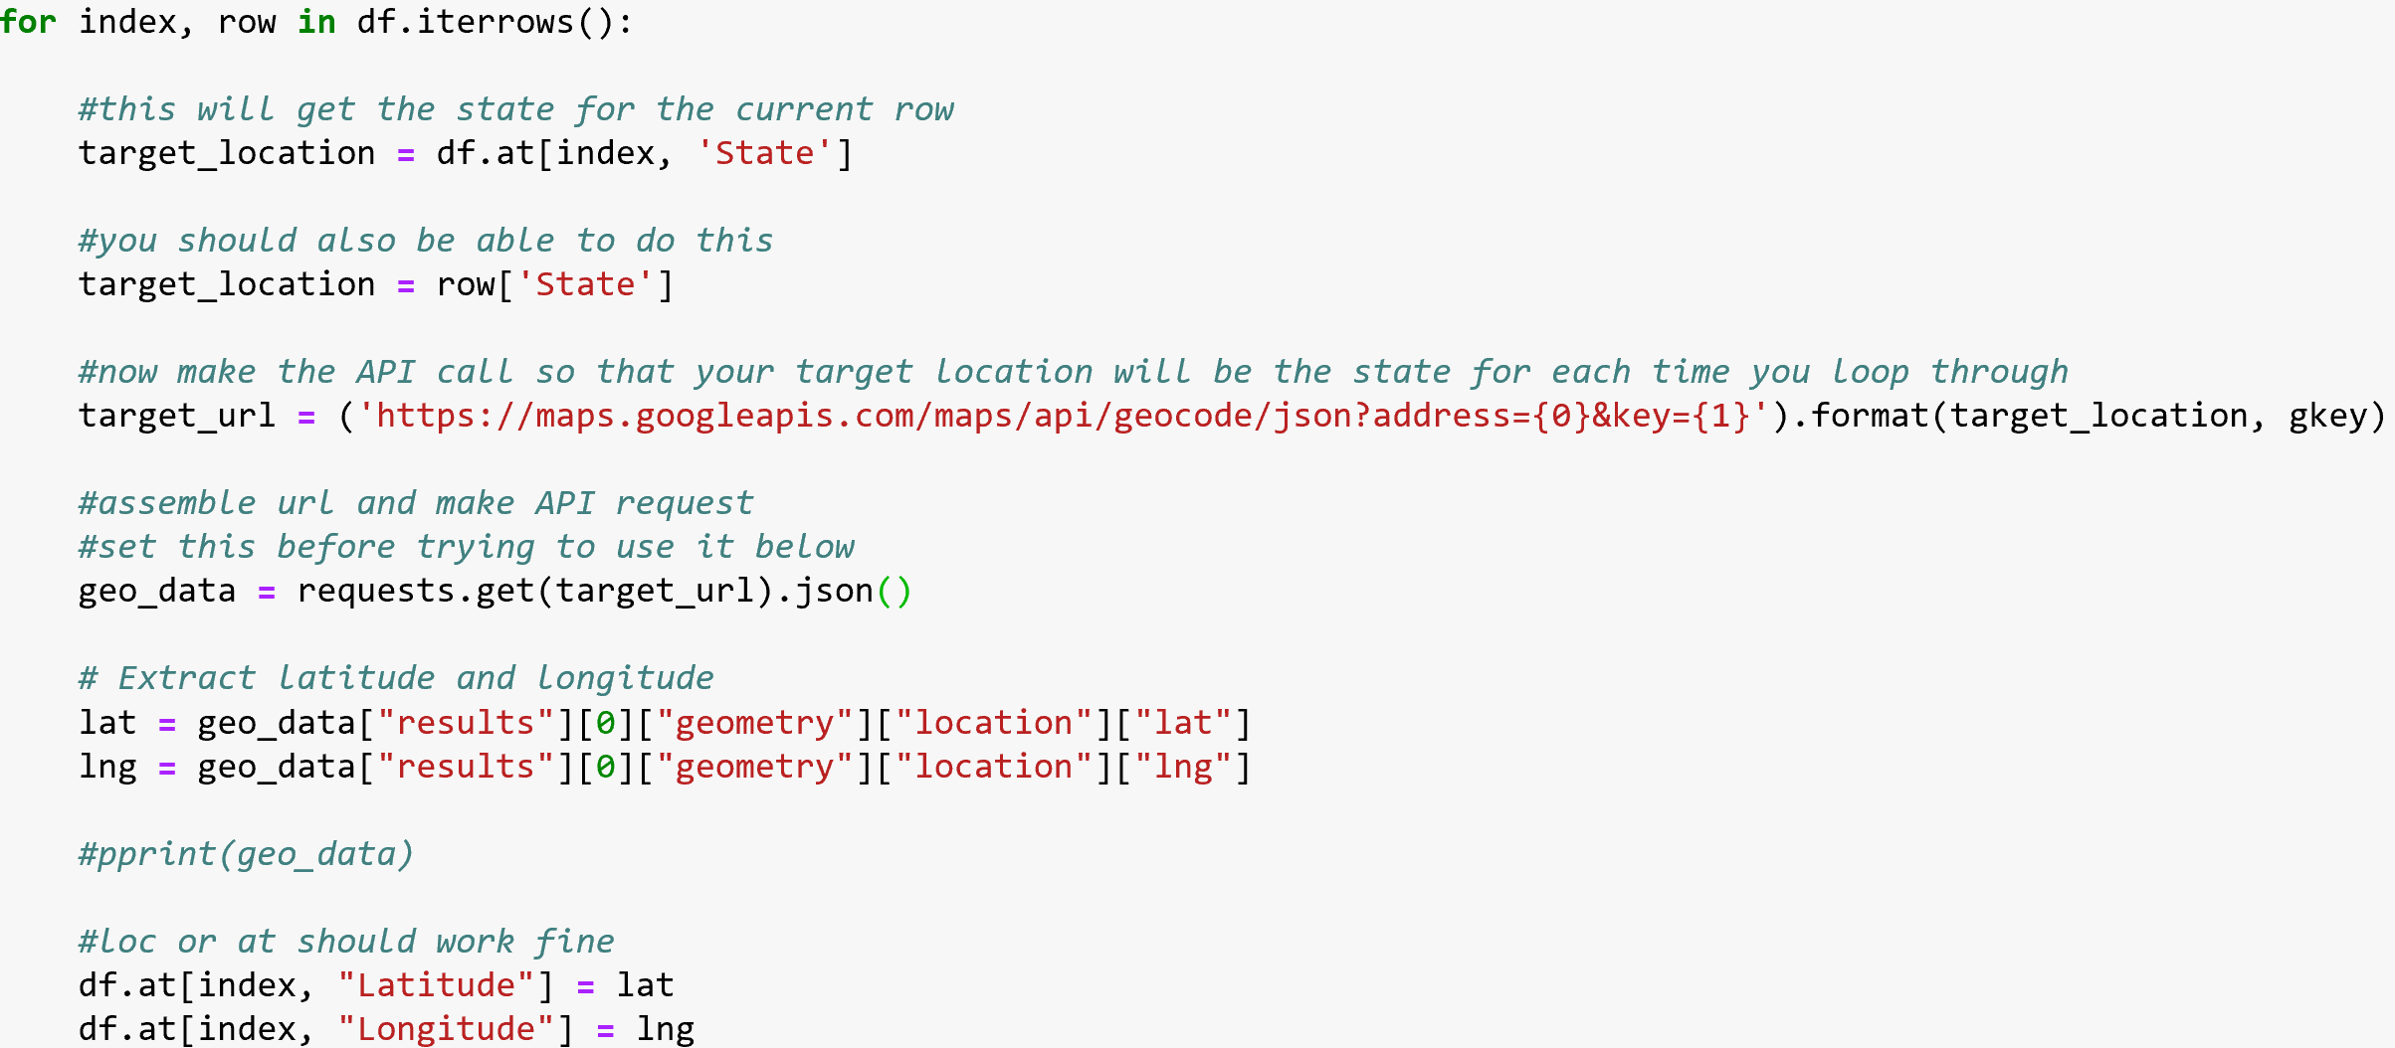

Slide 7
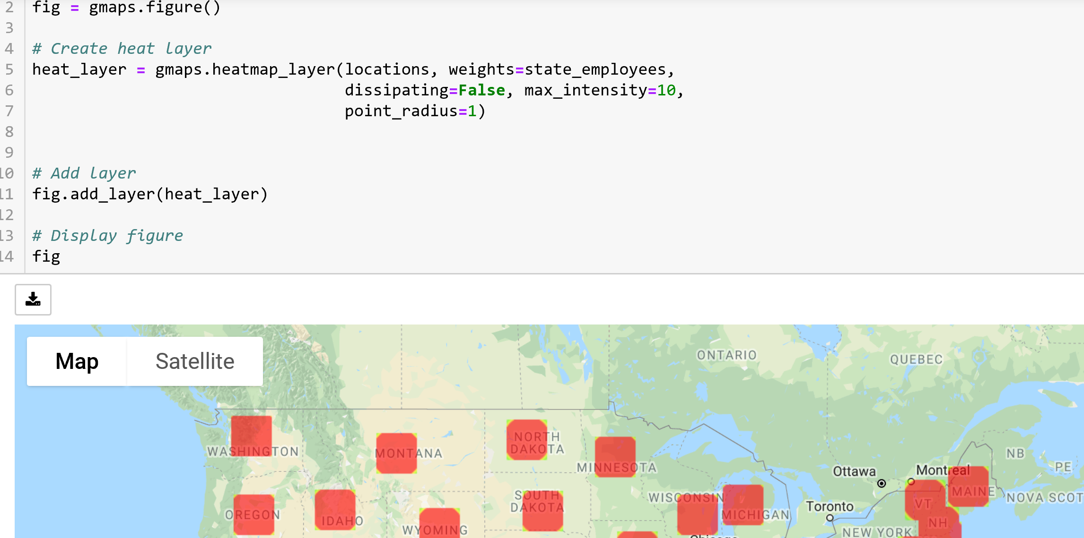

Slide 8
Heat Map Summary
We spent a lot of time on the data manipulation.
We were able to clean-up the code by doing things like method chaining.
Although outside the scope of our procedures, the data source had interesting information such as level of education of employees and salary of employees.
We were surprised that California has more government employees that any other state (the “DMV” has the most, but from an individual state perspective California has the most).
The data source had a number of unspecified information which we ignored.
Key finding: There are a lot of federal employees throughout the country not just in the DMV area.

Slide 9
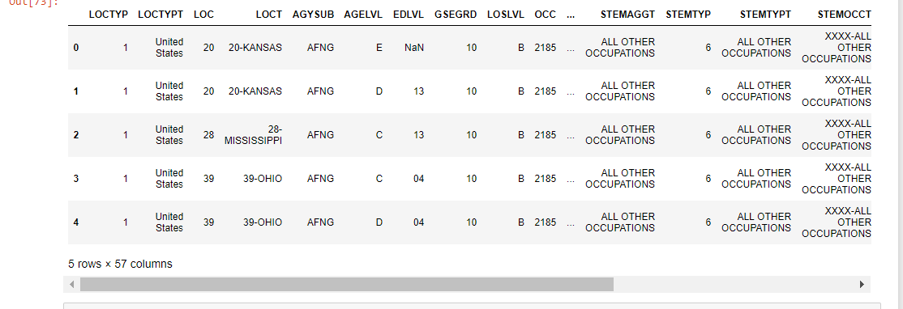
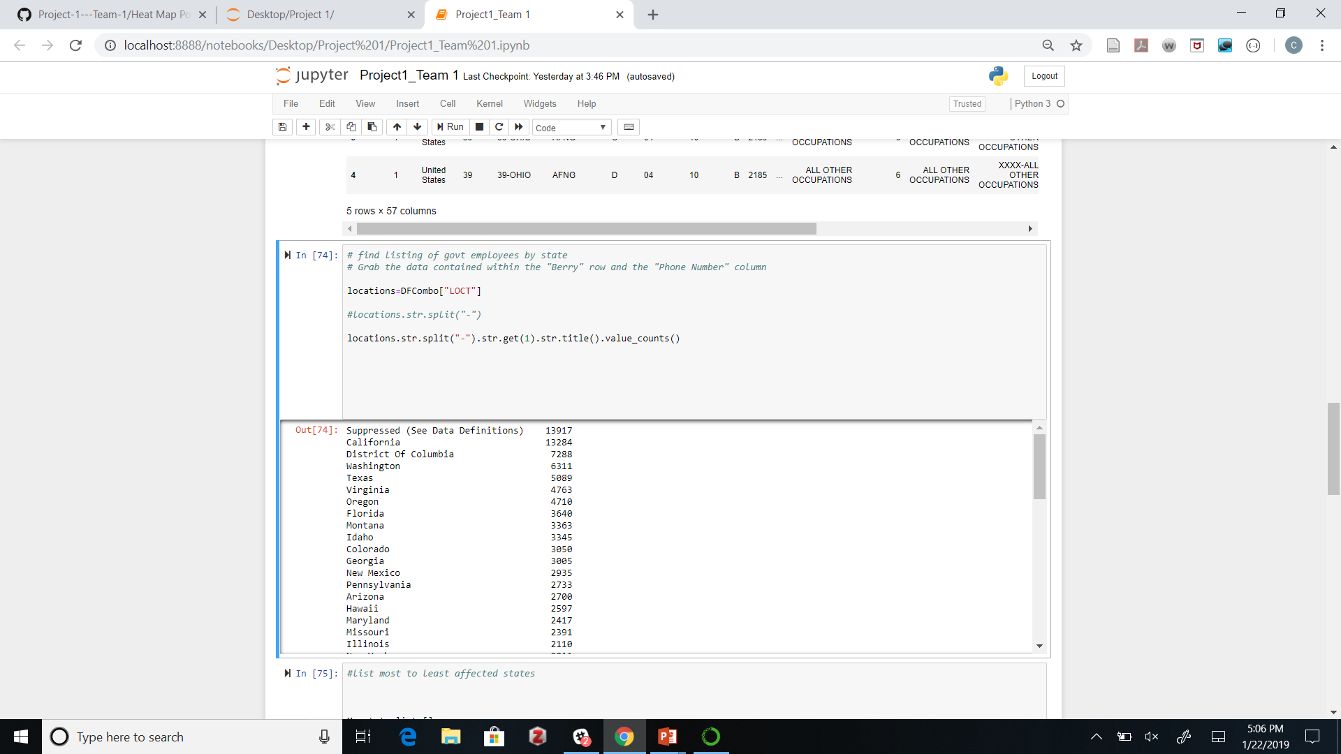
I Merge Data from CSV Files to get totals
I used a string to find data for States

Slide 10
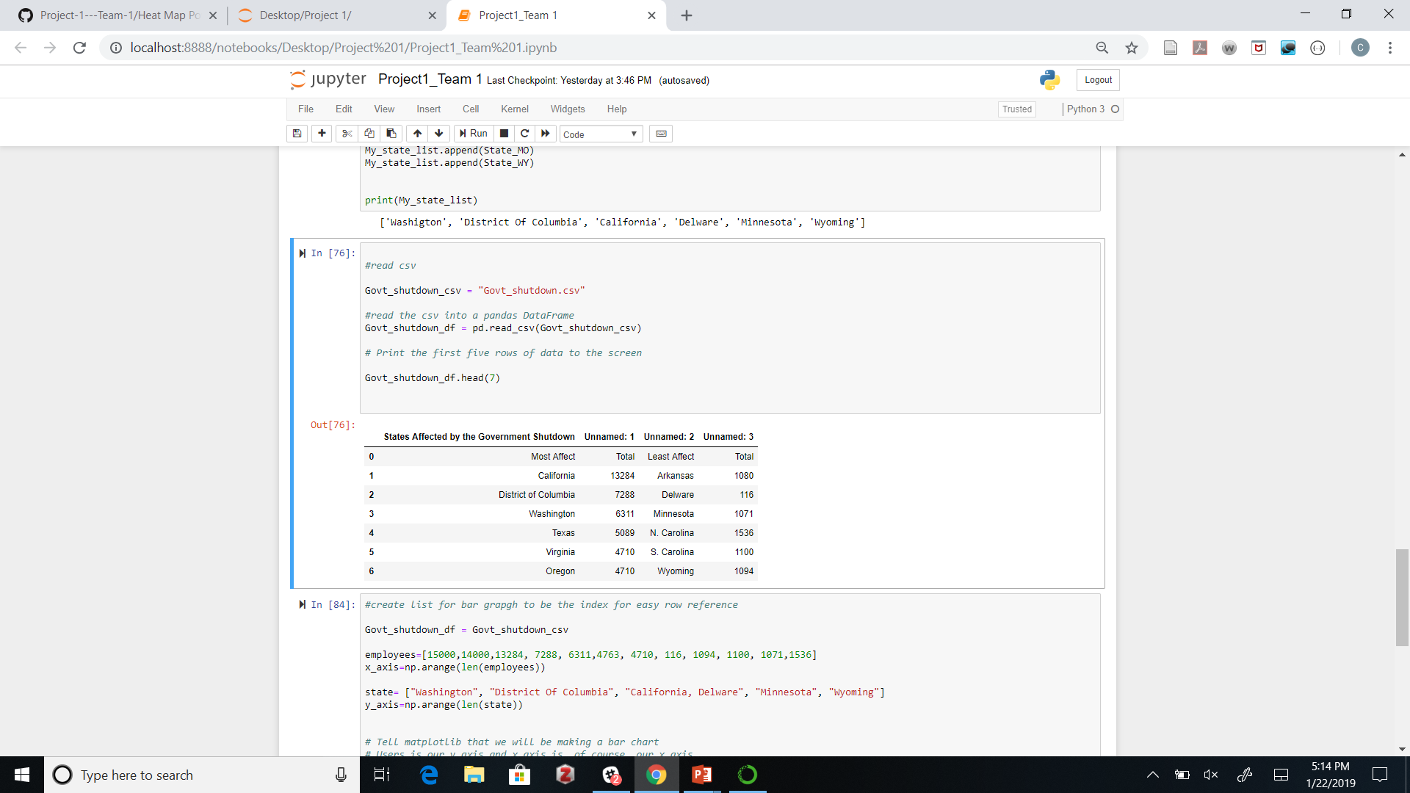
I used a list index to identify the Six States affected by the Shutdown from Greatest to least

Slide 11
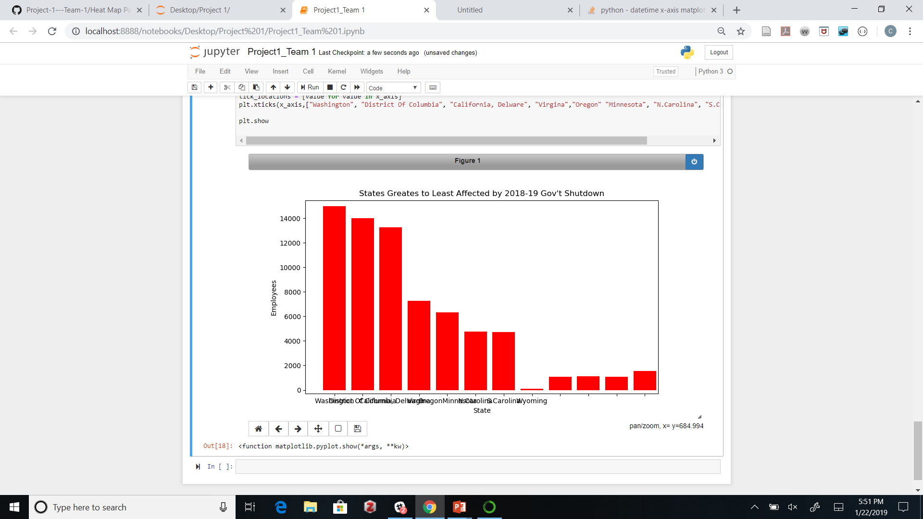

Slide 12
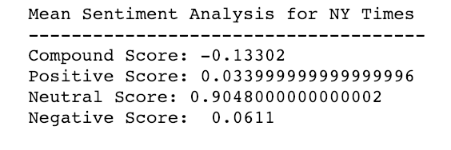
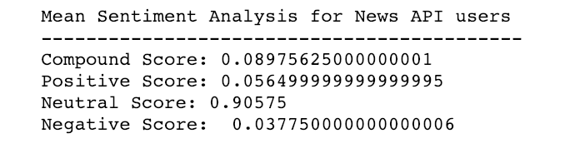
Media Sentiment Analysis

Slide 13
Twitter Analysis on Keywords
891 Tweets
Key words and phrases: Government Shutdown, Shutdown, Border Wall, The Wall
COMPOUND RESULTS: 0.001
Positive = 0.062
Neutral = 0.875
Negative = 0.063
Neutral: -0.05 to +0.05

Slide 14
Twitter Analysis on User Input
“Which term would you like to search for?”_______________________
 | Positive Score | Neutral Score | Negative Score | Compound Score
Search Term
Republican's Fault | 0.083 | 0.7504 | 0.1667 | -0.373265
 | Positive Score | Neutral Score | Negative Score | Compound Score
Search Term
Democrat's Fault | 0.09705 | 0.77015 | 0.1328 | -0.196655

Slide 15
Sentiment Analysis (SA)
Why Is it Important?
Businesses are heavily dependent on data
Data is unstructured text from emails, chats, social media, surveys, articles, and documents
Challenges (particularly Twitter and Facebook)
Short form text, Memes, Emoticons
Difficult to decipher
Time Consuming
SA enables companies to make sense out of data by automating the process and elicits vital insights

Slide 16
Challenges with SA
Understanding emotions through text is not always easy
Even humans can get mislead
Therefore, not 100% accurate
A single text may contain multiple sentiments all at once
Figurative speech (language) use words in a way that deviates from their conventionally accepted definitions in order to convey complicated meaning or heightened effect.
Emojis, Slangs and Emoticons:
However, VADER performs very well with emojis, slangs, emoticons and acronyms in sentences

Slide 17
The Compound Score
A NORMALIZED, WEIGHTED COMPOSITE SCORE
Computed by summing the valence scores of each word in the lexicon, adjusted according to the rules, and then normalized to be between -1 (the most extreme negative) and +1 (the most extreme positive).
Example: “This phone is super cool.”
Neg = 0.0 Neu = .326 Pos = .0674 = 1.00
Compound = 0.7351 Very Positive
In the case above: The rating for “Super” is 2.9 and the rating for “Cool” is 1.3.

Slide 18
What Makes A Difference?
PUNCTUATION = Exclamation marks increase magnitude (pos/neg)
CAPITALIZATION = All CAPS increase magnitude
DEGREE MODIFIERS = Such as “Extremely” good is more intense to the positive; “Marginally” good is more intense to the negative
CONJUNCTIONS = “But” signals a shift in sentiment polarity with the sentiment of the text following “but” being dominant
For example:
“The wall may be needed, but the government shutdown is extremely WRONG!!!.”
This sentence has mixed sentiment, with the latter half dictating the overall rating.

Slide 19
Conclusions
SA is a great tool for combing through large volumes of data in a short period of time
However, the greater the volume from the same media source, the more likely the results will normalize to 0 or Neutral
Individual sentences or phrases will better polarity results
Ways to work around this:
Use mixed sources of information
Limit the scope to a particular region or segment of the population
Look at sentiment changes over time, etc.
SA by itself is not perfect. Social Engineering is REAL. It is possible to manipulate SA through use of punctuation, capital letters, & certain words for intensity toward polarity – positive or negative – which influences others
Data Scientists must be able to discern what’s really happening with the data interpretation and know how to use various tools to give richer more accurate results.

